Slide 1
Analyses of Old “Prokaryotic” Proteins Indicate Functional Diversification in Arabidopsis and Oryza sativa
BCB546X
13th December 2019
Roshan Kulkarni
Zachayo Kazibwe
Amruta Bapat

Slide 2
Significance of the research
A eukaryotic genome is comprised of heterogeneous set of genes with differing functions and different evolutionary histories.
Several events such as mutation, duplication and divergence, lateral and horizontal transfer, de novo genesis of genes are responsible for the evolution of new genes/proteins
Proteins evolve within the constraints of their conserved function.
Protein sequence comparison is a powerful tool to understand genome evolution.

Slide 3
Defining old and new proteins in model plants
Arabidopsis (monocot) and Oryza sativa (dicot) shared a common ancestor about ~150–200 million years ago
Comparative analysis of Arabidopsis and Oryza sativa can provide insights into their evolutionary histories.
Approach : Presence or absence of orthologs in a wide range of bacterial species – old and new proteins respectively.

Slide 4
Data Sources
Protein and genome sequence data
Oryza sativa version 7.0 from http://rice.plantbiology.msu.edu
Arabidopsis version 10.0 from http:// www.arabidopsis.org
Prokaryotic protein sequences from http://www.ncbi.nlm.nih.gov/COG/
Genome sequences from bacterial species ftp://ftp.ncbi.nlm.nih.gov/genomes/refseq/bacteria/

Slide 5
Identification of old prokaryotic proteins
Used command line blast for sequence analysis - faster
Made BLAST database of Prokaryotic protein sequences
Fragmented multiple sequence files in 1000 sequence chunk files
BLASTp analysis of Arabidopsis vs Prokaryotic sequence database
BLASTp analysis of Oryza sativa sequences vs Prokaryotic sequence database

Slide 6
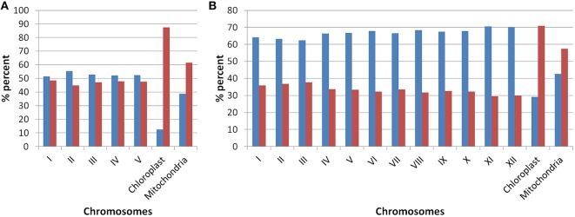
Chromosome localization of old and new proteins in Arabidopsis

Slide 7
Chromosome localization of old and new proteins in Rice

Slide 8
GO analysis
GO terms identified using GOSlim Assignments provided by Oryza Genome Annotation Project and Arabidopsis information source TAIR
Proteins identified were classified into broadly into three GOSlim categories – Cellular compartmentalization, Molecular function and Biological process

Slide 9
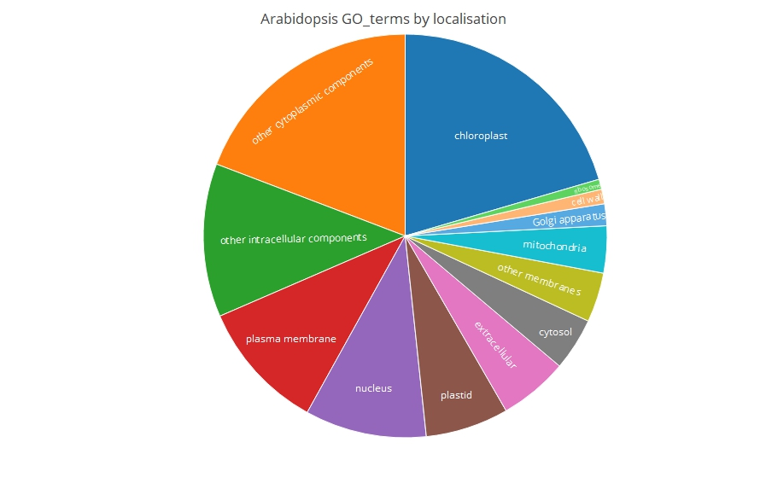
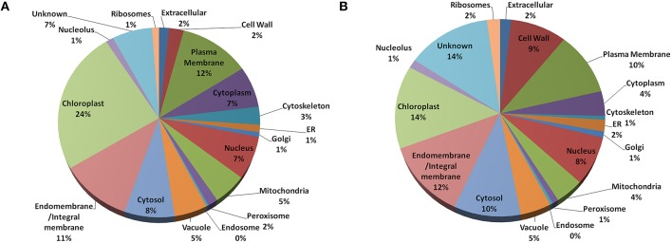
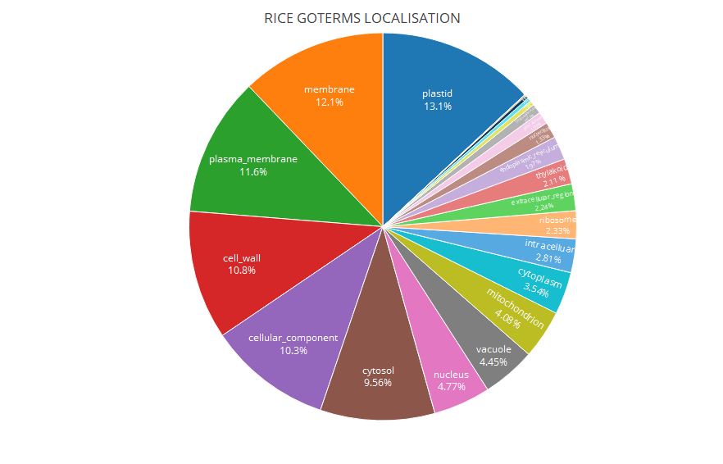
Cellular localization of old proteins
Arabidopsis
Arabidopsis
Rice
Rice

Slide 10
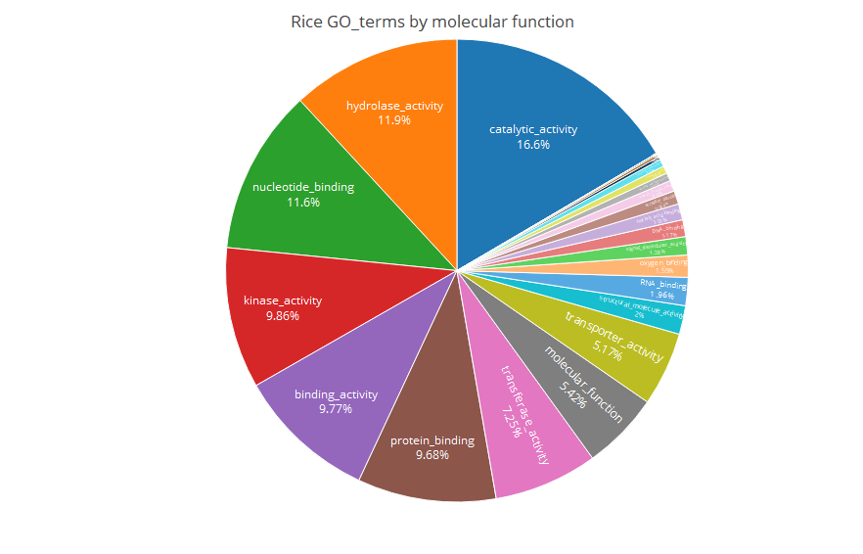
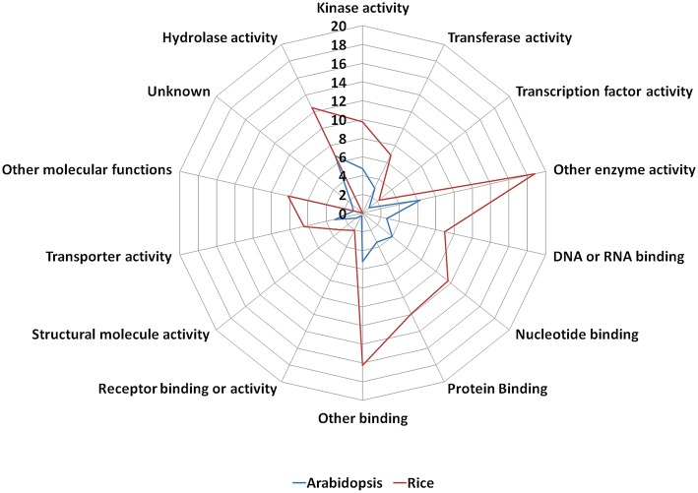
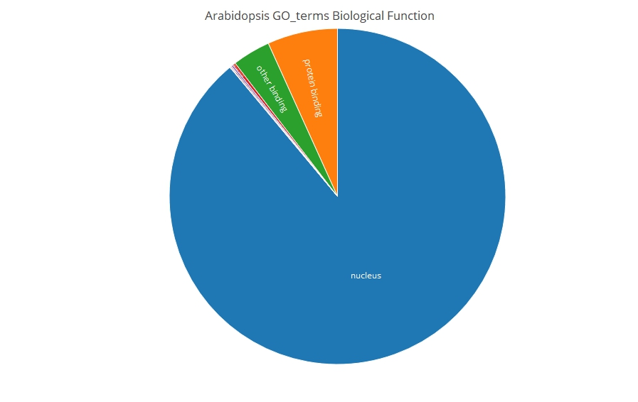
Functions of old proteins in Arabidopsis and Rice
Arabidopsis
Rice

Slide 11
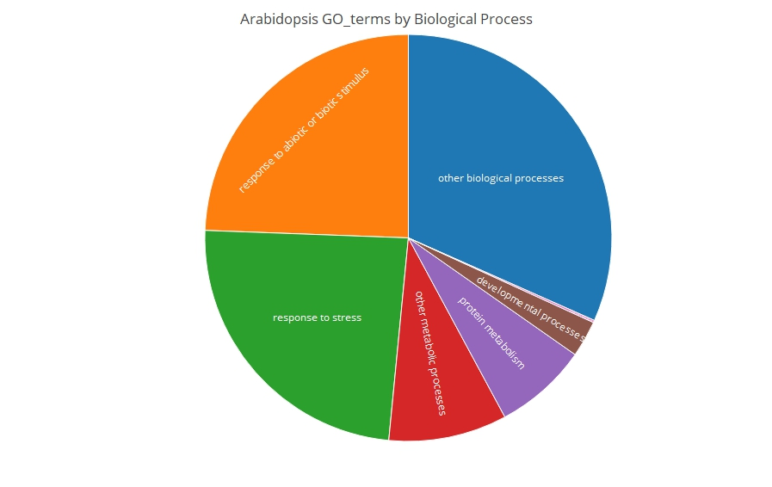
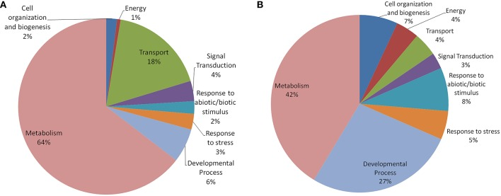
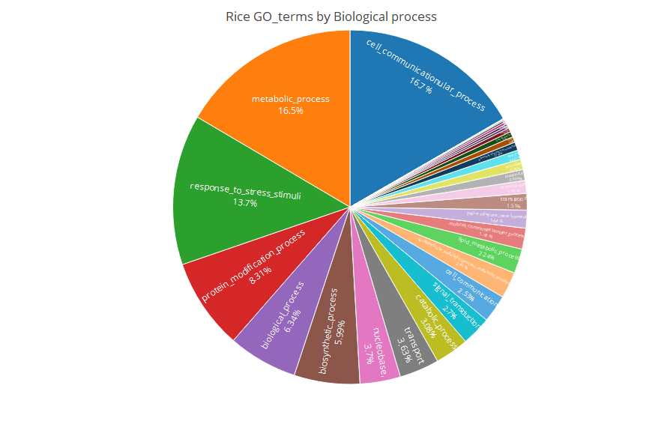
Biological processes
Arabidopsis
Arabidopsis
Rice
Rice

Slide 12
Conclusion
Old “prokaryotic” proteins found to be localized in various membrane bound regions
Primarily involved in various binding functions such as nucleotide binding,DNA, RNA binding indicating role in gene regulation
These proteins in Arabidopsis are involved primarily in metabolism while in Oryza old proteins involved primarily in cell communication and metabolism.
Old proteins may have undergone specialization of function and thereby divergence into new proteins.

